Slide 1
Neural Methods for Urban Analytics
Urban Analytics Summer School
Bill Howe

Slide 2

Example: Transportation Data
Example: Bike Share data
Babak Salimi
Luke Rodriguez

Slide 3
Origin-Destination Aggregated Data (“OD Data”)
Origin | Destination | Company | Gender | …
U District | U District | Bikes Inc. | Female | …
U District | U District | Bikes Inc. | Male | …
U District | U District | RideCorp | Female | …
U District | U District | RideCorp | Male | …
U District | Capitol Hill | Bikes Inc. | Female | …
Capitol Hill | U District | RideCorp | Female | …
Capitol Hill | U District | RideCorp | Male | …
…
Notes:
Running example – aggregated trips.
Julia – it would help visually to replace the count column with a bar that shows the magnitude of the count – round to a 10 and round it
Change neighborhoods to Seattle neighborhood
This way we could see the bars getting closer in the length once we mitigate

Slide 4
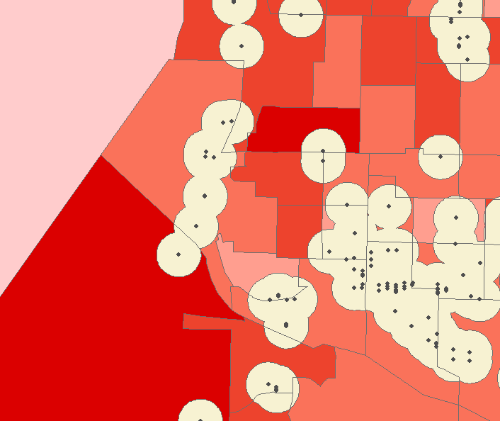
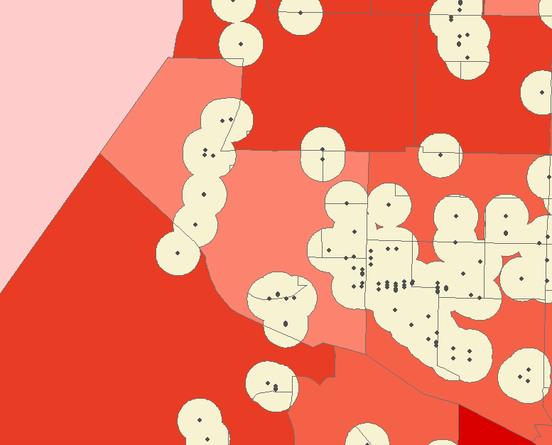
Aggregated to census tract level/city level

Slide 5
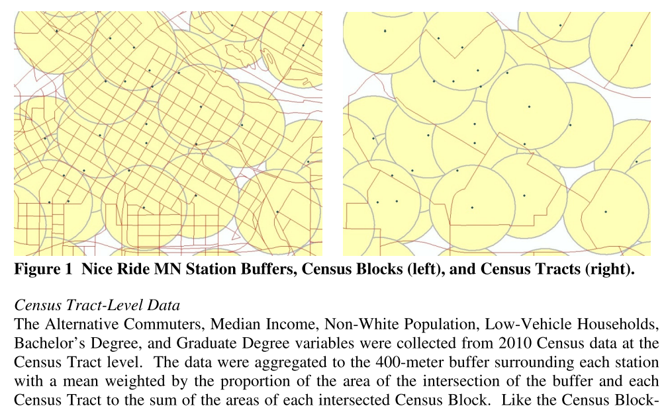
Rixey, R. "Station-level forecasting of bikesharing ridership: Station Network Effects in Three US Systems." Transportation Research Record: Journal of the Transportation Research Board 2387 (2013): 46-55. http://docs.trb.org/prp/13-1862.pdf

Slide 6
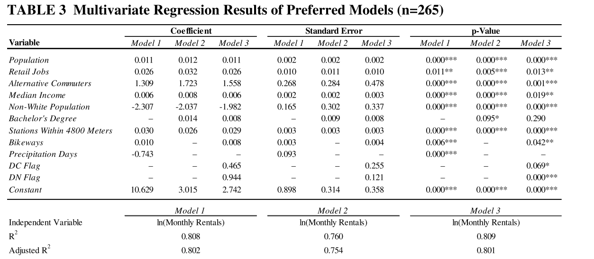
Notes:
Demand , our problem supply model

Slide 7
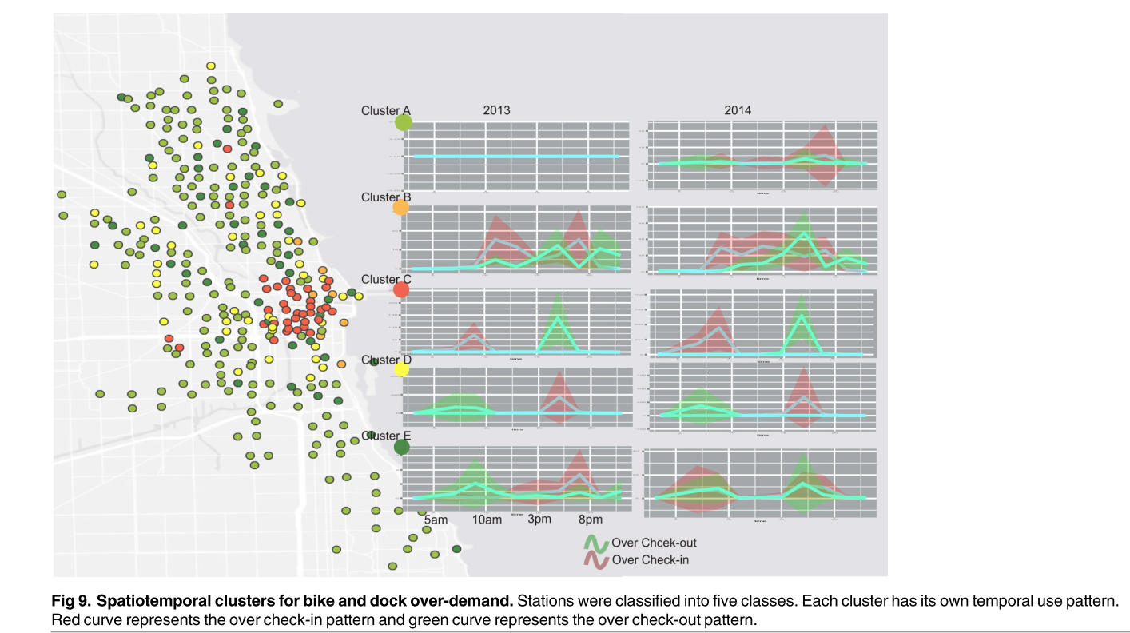
Supply/Demand/ Spatial Temporal Pattern
Zhou, Xiaolu. "Understanding spatiotemporal patterns of biking behavior by analyzing massive bike sharing data in Chicago." PloS one 10.10 (2015): e0137922.

Slide 8
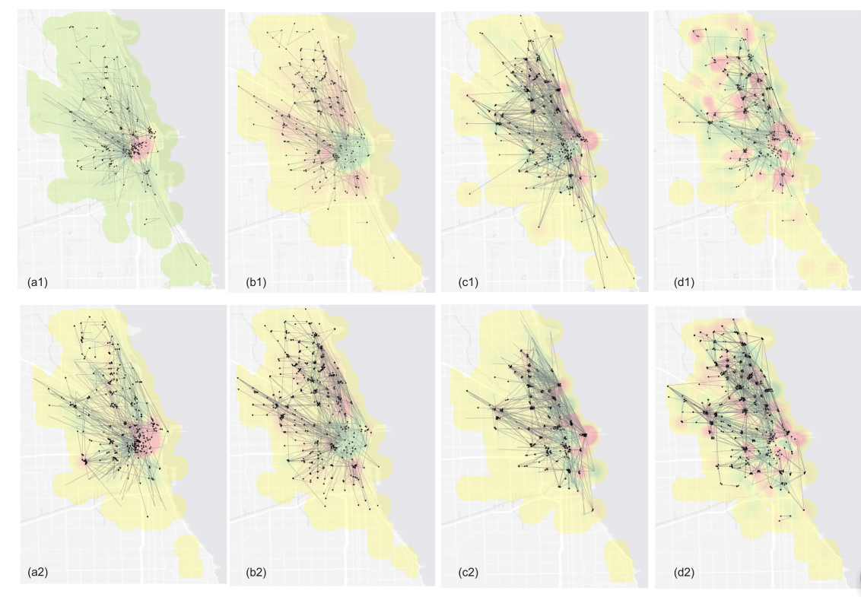

Slide 9
Evaluating Equity
 | white | black | ave_income /hh | Median car /hh | No car /hh | Age 65+ | >College Degree | <High school | Population | HH_cnt
in | 0.6809 | 0.0728 | 99777.4303 | 1.5531 | 0.2502 | 0.1092 | 0.5644 | 0.0539 | 227280.71 | 118507
out | 0.6457 | 0.0928 | 118764.33 | 1.9543 | 0.1189 | 0.1386 | 0.5141 | 0.0738 | 453218.29 | 200820
total | 0.6586 | 0.0862 | 112171.0000 | 1.8000 | 0.1693 | 0.1275 | 0.5331 | 0.0669 | 680499.00 | 319327
In = descriptive statistics for those areas “covered” by a bike
Out = descriptive statistics for those areas “not covered” by a bike
Goal: Compare these statistics to evaluate equity of availability, for different demographics

Slide 10
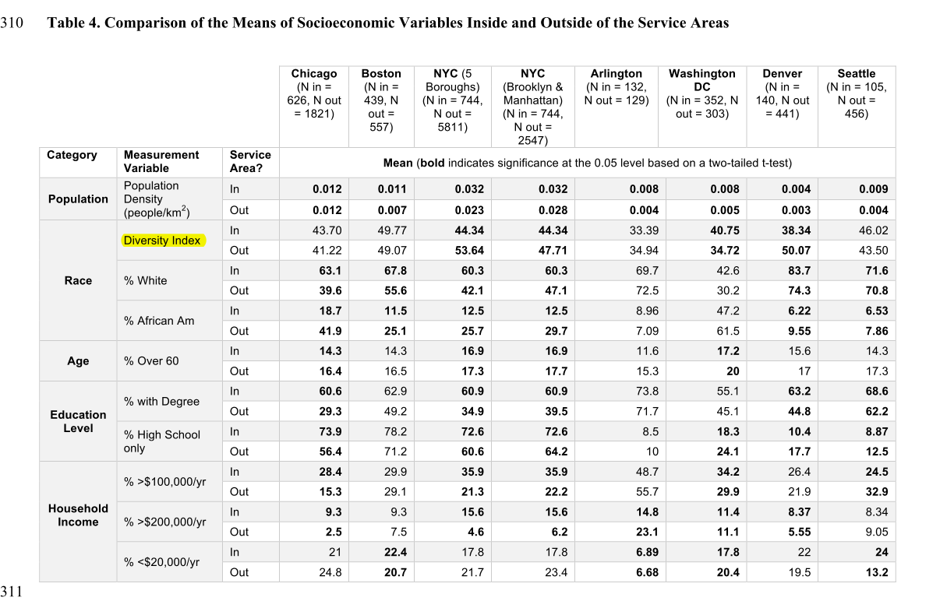
QUANTIFYING THE EQUITY OF BIKESHARE ACCESS IN US CITIES, 2015

Slide 11
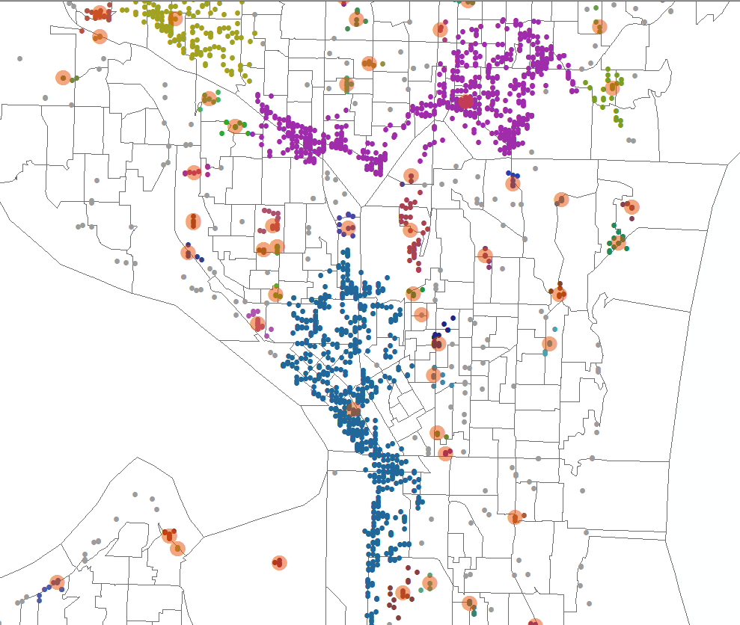
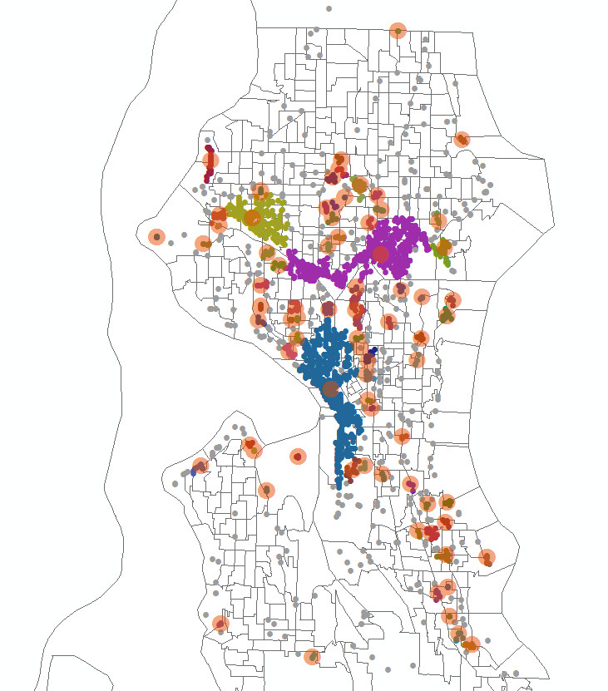
Clustering – DBSCAN

Slide 12
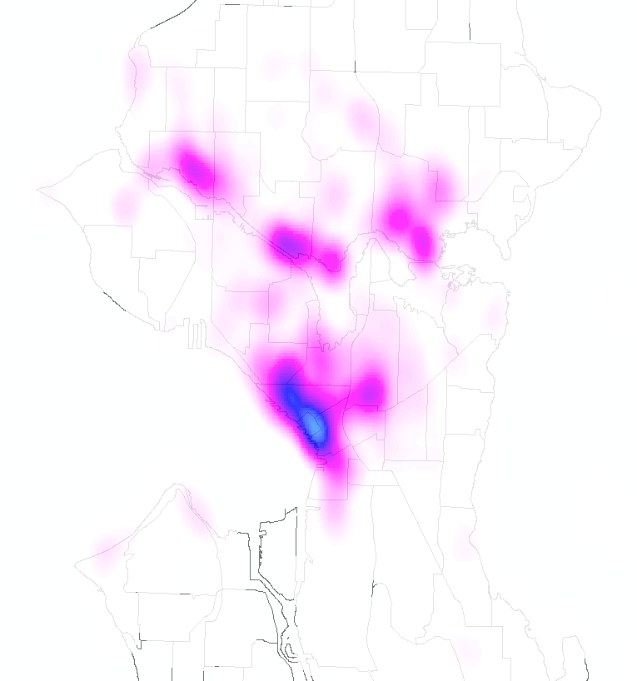
Kernel Density

Slide 13
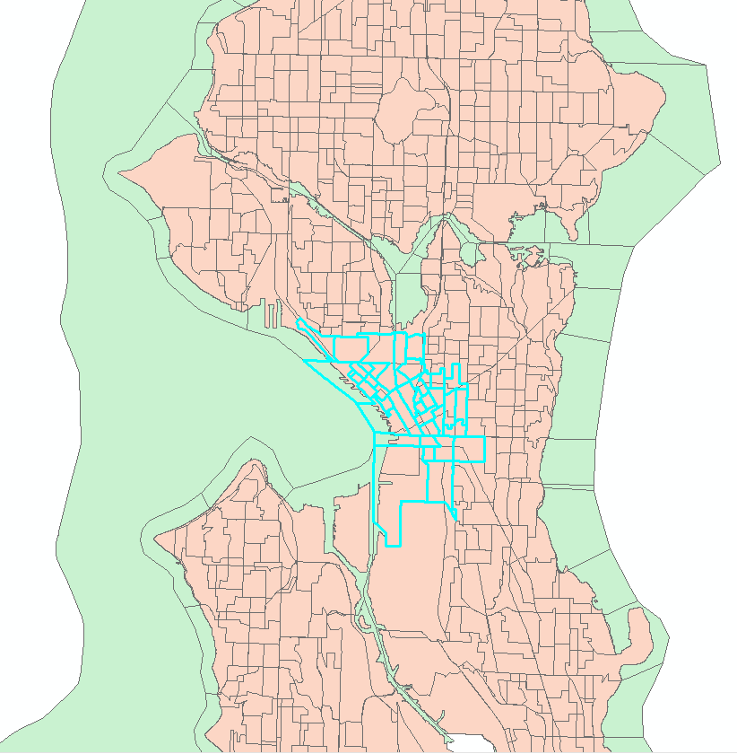
Equity - Downtown
Downtown population: 8.8%
U-district population: 6.3%
Downtown population:
more diverse, lower income, fewer cars, fewer college degree
 | white | black | ave_income /hh | Median car /hh | No car /hh
downtown | 0.5878 | 0.1221 | 90156.8348 | 1.0893 | 0.4524
Udist | 0.6551 | 0.0247 | 85282.0321 | 1.5281 | 0.2860
Seattle | 0.6586 | 0.0862 | 112171.0000 | 1.8000 | 0.1693
 | Age 65+ | >College Degree | <High school | Population | HH_cnt
downtown | 0.1426 | 0.4874 | 0.1014 | 60357 | 37216
Udist | 0.0546 | 0.6143 | 0.0261 | 43128 | 16030
total | 0.1275 | 0.5331 | 0.0669 | 680499 | 319327

Slide 14
Equity- downtown
2017-10-01 – 2018-04-31
City-wide
 | white | black | ave_income /hh | Median car /hh | No car /hh | Age 65+ | >College Degree | <High school | Population | HH_cnt
in | 0.6769 | 0.0753 | 100154.877 | 1.5288 | 0.2592 | 0.1055 | 0.5665 | 0.0556 | 235018 | 122594
out | 0.6479 | 0.0919 | 119423.391 | 1.9656 | 0.1150 | 0.1390 | 0.5148 | 0.0731 | 445481 | 196733
total | 0.6586 | 0.0862 | 112171.000 | 1.8000 | 0.1693 | 0.1275 | 0.5331 | 0.0669 | 680499 | 319327
Downtown only
 | white | black | ave_income /hh | Median car /hh | No car /hh | Age 65+ | >College Degree | <High school | Population | HH_cnt
in | 0.6052 | 0.1124 | 92049.422 | 1.0870 | 0.4528 | 0.1367 | 0.5016 | 0.0915 | 52083 | 32883
out | 0.4767 | 0.1812 | 77661.330 | 1.1235 | 0.4411 | 0.1764 | 0.3986 | 0.1640 | 8274 | 4333
total | 0.5878 | 0.1221 | 90156.834 | 1.0893 | 0.4524 | 0.1426 | 0.4874 | 0.1014 | 60357 | 37216
Summary: visibly inequitable in terms of race, income, age, education; favors higher income;
Notes:
Visualization/ statistical tests / normalize /

Slide 15
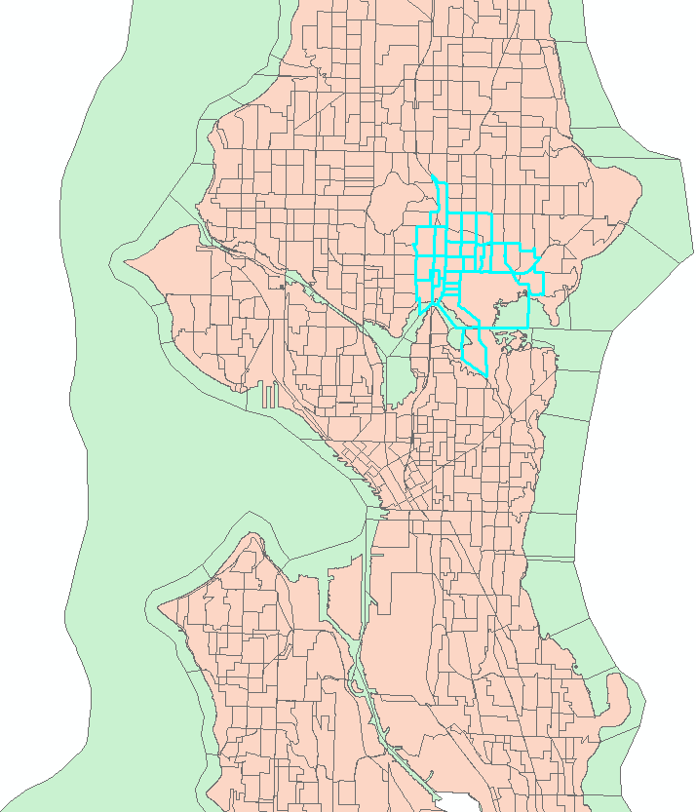
Equity – U-district
Downtown population: 8.8%
U-district population: 6.3%
U-district population:
fewer African Americans, lower income, fewer cars,
More college degree, younger
 | white | black | ave_income /hh | Median car /hh | No car /hh
downtown | 0.5878 | 0.1221 | 90156.8348 | 1.0893 | 0.4524
Udist | 0.6551 | 0.0247 | 85282.0321 | 1.5281 | 0.2860
total | 0.6586 | 0.0862 | 112171.0000 | 1.8000 | 0.1693
 | Age 65+ | >College Degree | <High school | Population | HH_cnt
downtown | 0.1426 | 0.4874 | 0.1014 | 60357 | 37216
Udist | 0.0546 | 0.6143 | 0.0261 | 43128 | 16030
total | 0.1275 | 0.5331 | 0.0669 | 680499 | 319327

Slide 16
Equity – U-district
2017-10-01 – 2018-04-31
City-wide
 | white | black | ave_income /hh | Median car /hh | No car /hh | Age 65+ | >College Degree | <High school | Population | HH_cnt
in | 0.6769 | 0.0753 | 100154.877 | 1.5288 | 0.2592 | 0.1055 | 0.5665 | 0.0556 | 235018 | 122594
out | 0.6479 | 0.0919 | 119423.391 | 1.9656 | 0.1150 | 0.1390 | 0.5148 | 0.0731 | 445481 | 196733
total | 0.6586 | 0.0862 | 112171.000 | 1.8000 | 0.1693 | 0.1275 | 0.5331 | 0.0669 | 680499 | 319327
U-district only
 | white | black | ave_income /hh | Median car /hh | No car /hh | Age 65+ | >College Degree | <High school | Population | HH_cnt
in | 0.6303 | 0.0261 | 71808.469 | 1.4327 | 0.3218 | 0.0485 | 0.6013 | 0.0274 | 34278 | 12821
out | 0.7494 | 0.0190 | 139868.90 | 1.9110 | 0.1429 | 0.0777 | 0.6638 | 0.0206 | 8850 | 3209
total | 0.6551 | 0.0247 | 85282.032 | 1.5281 | 0.2860 | 0.0546 | 0.6143 | 0.0261 | 43128 | 16030
Summary: Inverse inequity in race, income, and education; inequity in terms of age, car.
Notes:
Need to investigate U-dist in a smaller spatial range.

Slide 17
Equity – exclude downtown and U-district
2017-10-01 – 2018-04-31
City-wide
 | white | black | ave_income /hh | Median car /hh | No car /hh | Age 65+ | >College Degree | <High school | Population | HH_cnt
in | 0.6769 | 0.0753 | 100154.877 | 1.5288 | 0.2592 | 0.1055 | 0.5665 | 0.0556 | 235018 | 122594
out | 0.6479 | 0.0919 | 119423.391 | 1.9656 | 0.1150 | 0.1390 | 0.5148 | 0.0731 | 445481 | 196733
total | 0.6586 | 0.0862 | 112171.00 | 1.8000 | 0.1693 | 0.1275 | 0.5331 | 0.0669 | 680499 | 319327
City-wide: exclude downtown and u-district
 | white | black | ave_income /hh | Median car /hh | No car /hh | Age 65+ | >College Degree | <High school | Population | HH_cnt
in | 0.7144 | 0.0733 | 108431.19 | 1.7390 | 0.1633 | 0.1076 | 0.5821 | 0.0492 | 148657 | 76891
out | 0.6476 | 0.0925 | 119951.62 | 1.9864 | 0.1069 | 0.1399 | 0.5071 | 0.0745 | 431755 | 190610
total | 0.6650 | 0.0877 | 116804.97 | 1.9167 | 0.1226 | 0.1317 | 0.5266 | 0.0679 | 580412 | 267501
Summary: Compared to city-wide, increased differences in race and education.

Slide 18
Bikeshare Equity
Summary:
Seattle: Seattle as whole exhibits inequity of access to shared bikes service areas in terms of race, age, education, and # of cars. Inverse equity is observed for income.
Downtown: Compared to city-wide equity, larger differences are observed for race, age, and education. Higher income population have more access to bikeshare services than lower income population.
U-district: Inverse equity is observed for race and education. People who have access to bikeshare services have significantly lower income than those who do not.
Seattle without U-district and downtown: Similar equity pattern to city-wide statistics, but with larger differences in race and education.

Slide 19
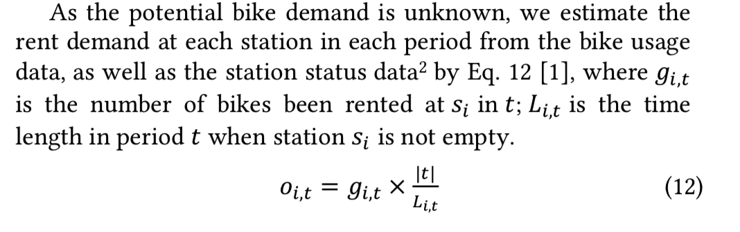
Demand model
(Yexin Li et al., 2018)

Slide 20
Defining the demand prediction problem
Use 24 x 7 h usage data predict next 1 hour of usage
Additional useful features:
Weather features (humidity, wind speed, precipitation, temperature)
Terrain (elevation)
Transportation (network, bus stops, light rail stations)
Temporal (time of day, day of week, season, holidays)
POI features
Baselines:
Historical Average
ARIMA/ SARIMA/ VAR
LSTM / Vanilla RNN
Gradient Boosted Regression Tree / RF
Evaluation
RMSE/ MAE

Slide 21
How to model spatial dependence?
VAR (vector autoregression)
GTWR (geographical and Temporal Weighted Regression)
RNN variants(i.e., encode spatial info as features)
Graphical model + RNN
(e.g., https://arxiv.org/pdf/1804.00684.pdf)
CNN variants
(e.g. Zhang, Junbo, et al. "Predicting citywide crowd flows using deep spatio-temporal residual networks." AAAI, 2018: https://www.sciencedirect.com/science/article/pii/S0004370218300973 )
RNN + CNN
e.g.: ConvLSTM
GAN
3D CNN

Slide 22
Baselines - no auxiliary features
2017-10-01 - 2018-04-30 lime data trip starts
training: 2017-10-01 - 2018-03-30 ; test: 2018-04-01 - 2018-04-30
Use one week data to predict next hour # of trip starts
 | RMSE | MAE
previous week Average | 1.3526 | 0.3935
average of previous hour h day of week d | 1.1765 | 0.3094
previous observation | 1.1847 | 0.3218
ARIMA | 1.7042 | 0.3354
SARIMA | 1.0196 | 0.3011
LSTM | 0.9769 | 0.2962
ConvLSTM | 1.0606 | 0.2598
Notes:
try last 24 hours to predict next hour
try attention- model

Slide 23
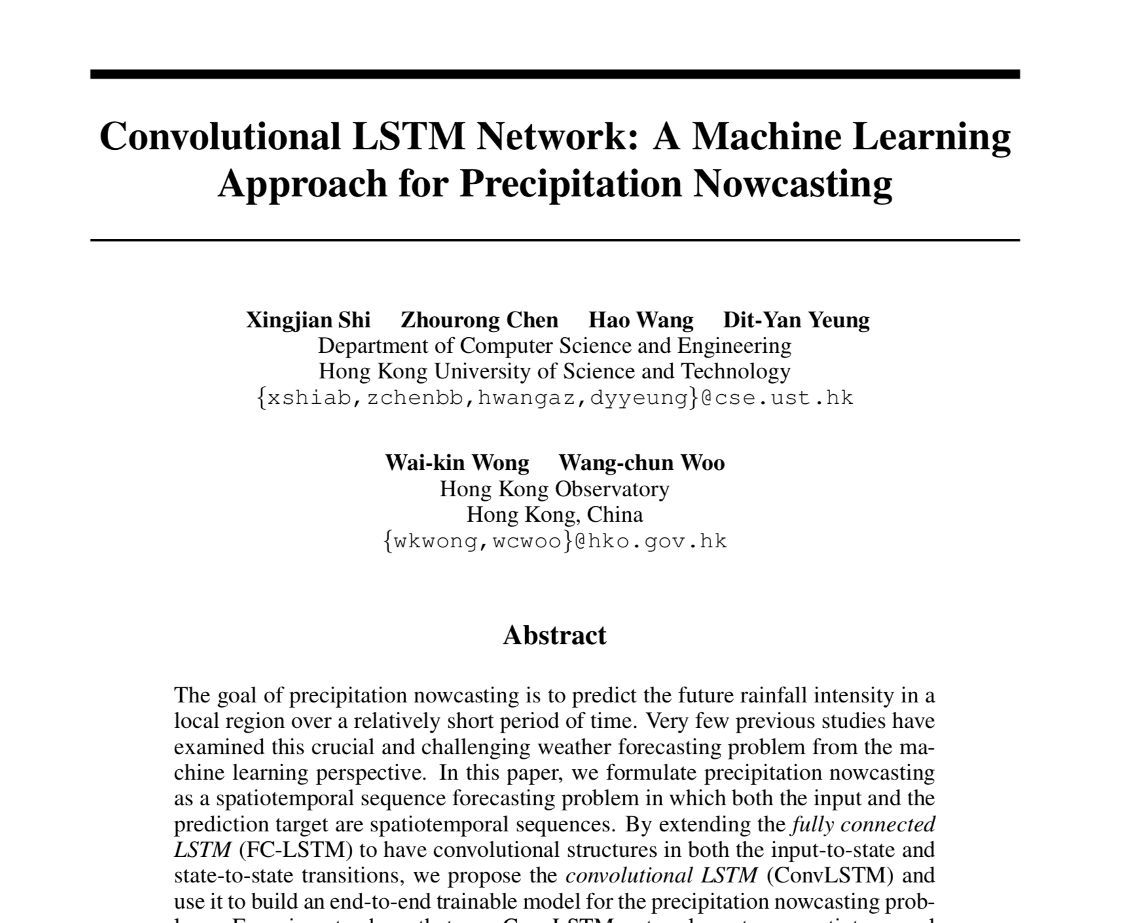

Slide 24
ConvLSTM model
Convolutional long short-term memory (ConvLSTM) model
Two key components:
Convolutional layers
Long short-term memory (LSTM) cells in recurrent neural network (RNN) model
X. Shi, Z. Chen, H. Wang, D.Y. Yeung, W.K. Wong, and W.C. Woo. Convolutional LSTM network: A machine learning approach for precipitation nowcasting. NIPS 2015.

Slide 25
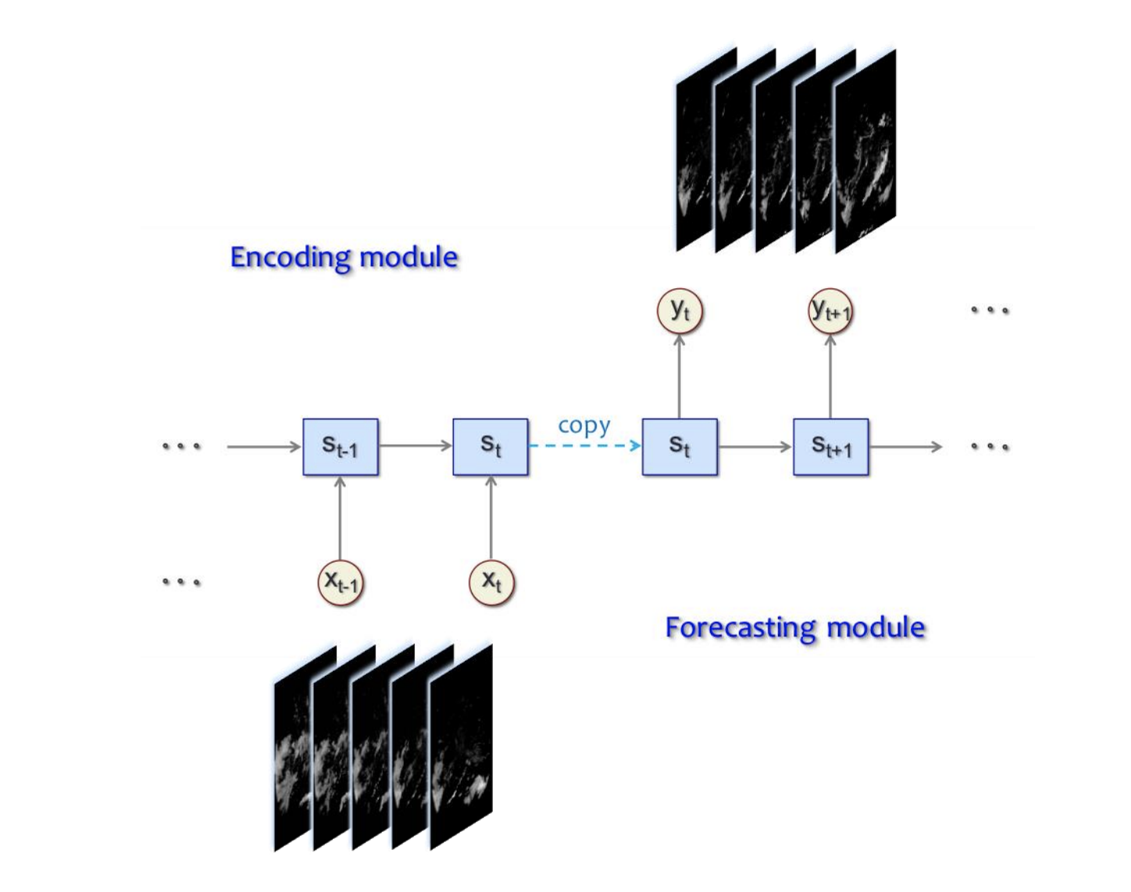
Spatiotemporal encoding-forecasting model

Slide 26
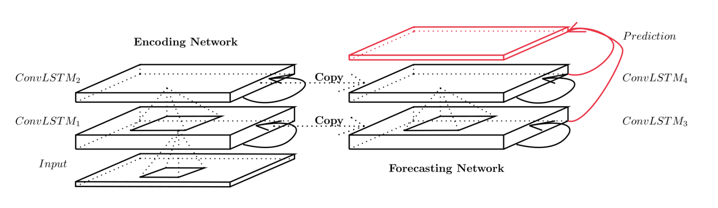
Encoding-forecasting ConvLSTM network
Last states and cell outputs of encoding network become initial states and cell outputs of forecasting network
Encoding network compresses the input sequence into a hidden state tensor
Forecasting network unfolds the hidden state tensor to make prediction

Slide 27
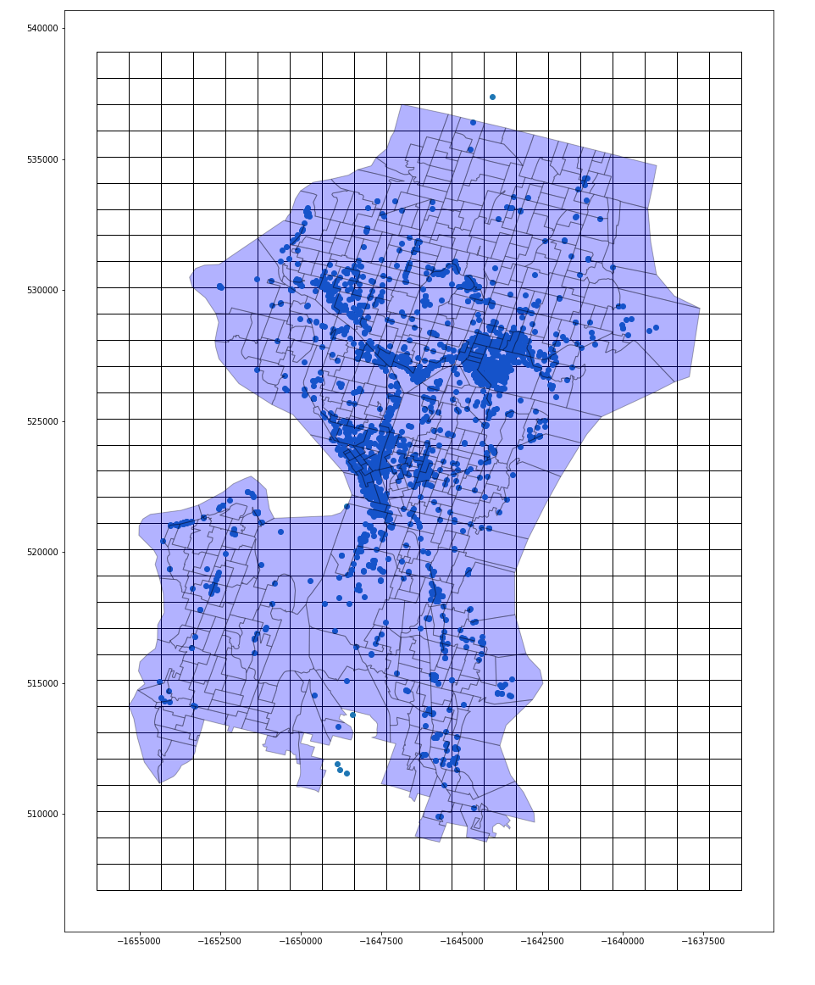
Baselines - ConvLSTM
https://arxiv.org/abs/1506.04214
https://www.tensorflow.org/api_docs/python/tf/contrib/rnn/ConvLSTMCell
Used features: [Native American Percentage, no car household, age over 65, population, poverty perc]
 | RMSE | MAE
ConvLSTM (no exogenous data) | 1.0606 | 0.2598
ConvLSTM (with demographic data - Late Fusion) | 1.0439 | 0.2536

Slide 28
Baselines
2017-10-01 - 2018-10-31 lime data trip starts
training: 2017-10-01 - 2018-08-31 ; test: 2018-09-01 - 2018-10-31： Use one week data to predict next hour # of trip starts
 | RMSE | MAE
previous week Average | 2.5102 | 0.6794
average of previous hour h day of week d | 2.1547 | 0.4838
previous observation | 1.9312 | 0.5173
ARIMA | 3.59652 | 0.5383
SARIMA | / | /
LSTM | 1.8314 | 0.4679
ConvLSTM | 1.9107 | 0.4544
ConvLSTM with 10 demographic features | 1.8630 | 0.4197
3D CNN | 1.6802 | 0.3918
3D CNN with 10 demographic features | 1.5751 | 0.3811
Notes:
try last 24 hours to predict next hour
try attention- model

Slide 29
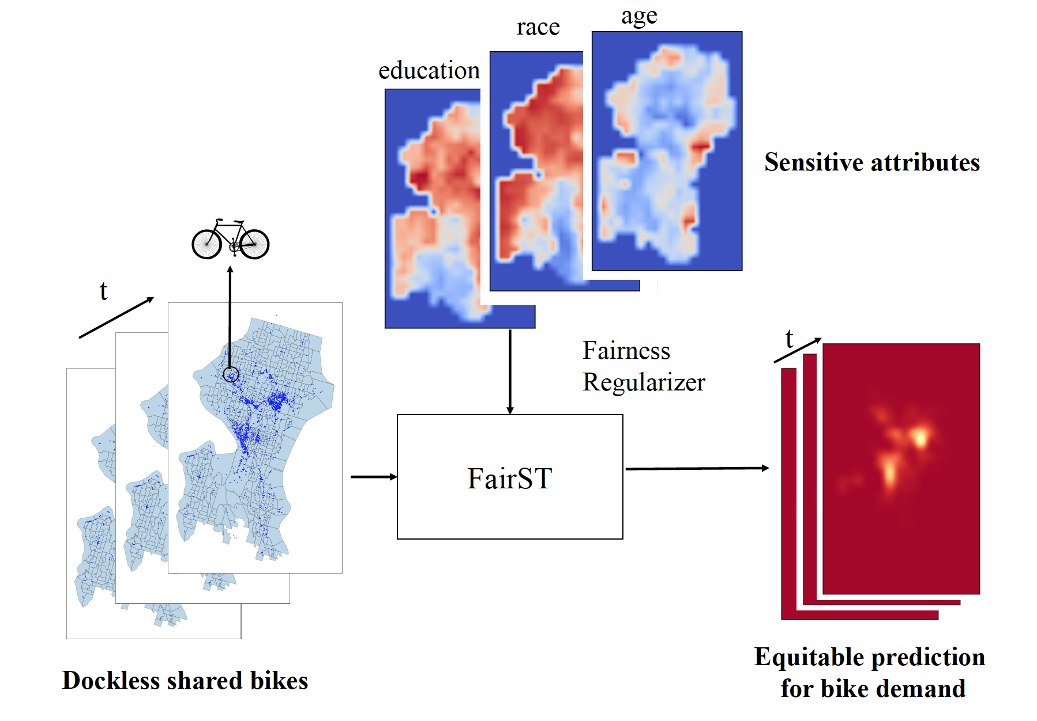
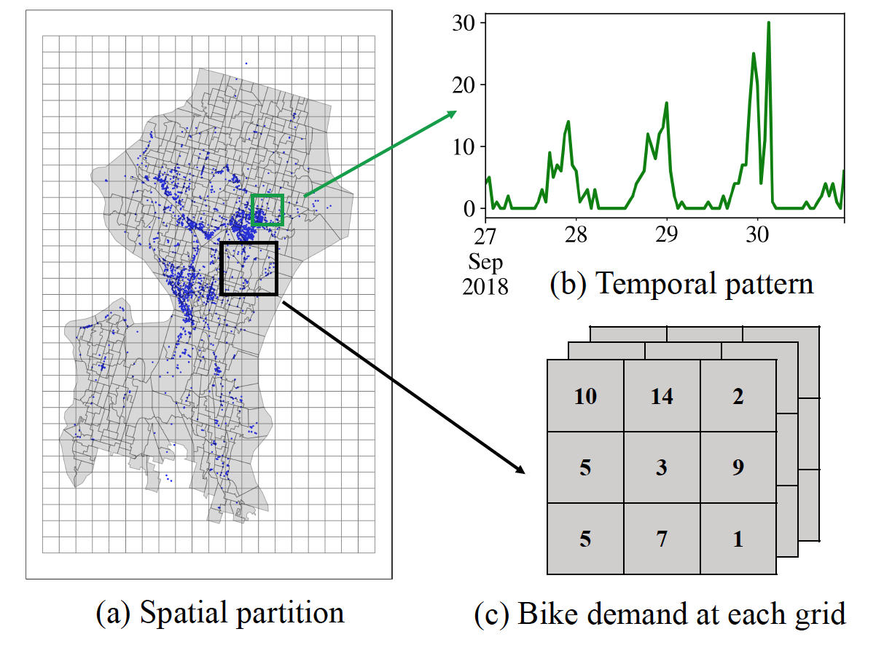
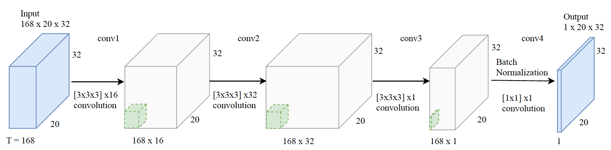
FairST: Adding Fairness to 3dCNNs

Slide 30
Results
Table of baselines, global RMSE -> “State of the art 3D Conv methods work best”
MethodX vs. MethodX + Weather + Demographics -> “Demographics matter”
Map of error with and without demographics -> error varies with demographics -> demand model is naturally unfair ->mobility services will be provisioned unfairly
????? -> our solution fixes the problem

Slide 31
Meeting with Steve on Equity (Nov. 29)
How to use statistical test to judge the difference between an equitable situation VS population inside service area
For each day (or week)
get demographics inside service areas from bikeshare data (e.g.: age65 = 0.9)
random sample 2k points along road networks. Compute demographics inside these buffers. Form a 2k vector
Do t-test with the 2k data points VS demo stats in service area, compute p_val.
Form a time series for each demographic attributes. Form another time series with randomly sampled 2k points stat. These two lines should not cross if not equitable
Form a baseline comparison with citywide ground truth VS randomly sampled 2k points along road network.

Slide 32
Feb 14
Equity paper
General Exam
May 9 - 25 :
week of May 20: am / pm 10 slots
KDD paper generalization
Then: application: crime / NY taxi : 3d+2d+ 1d data integration ->
Then design software
clean code / 1d, 2d, 3d files
one way to use the tool: synthetic datasets: fair prediction
seq to seq (1 week) prediction / make animations first. Project website. Create a project webpage.
adjust red/ yellow scale. Make a better map. with Seattle contour

Slide 33
Fused Model V1
Feb 28, 2019

Slide 34
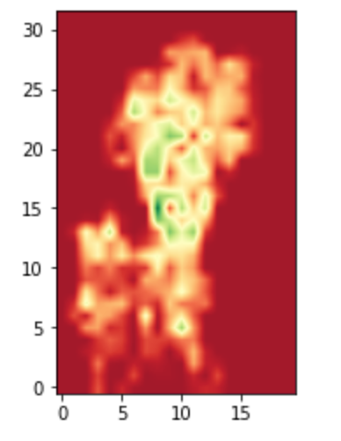
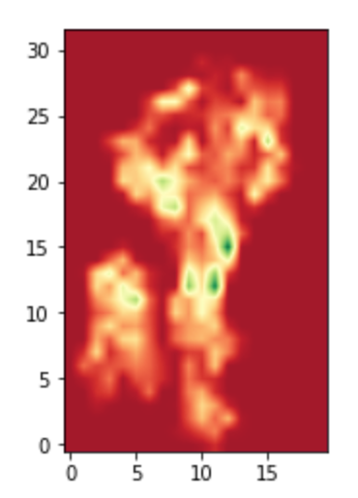
2d Features
bike lane count
Steep slope count

Slide 35
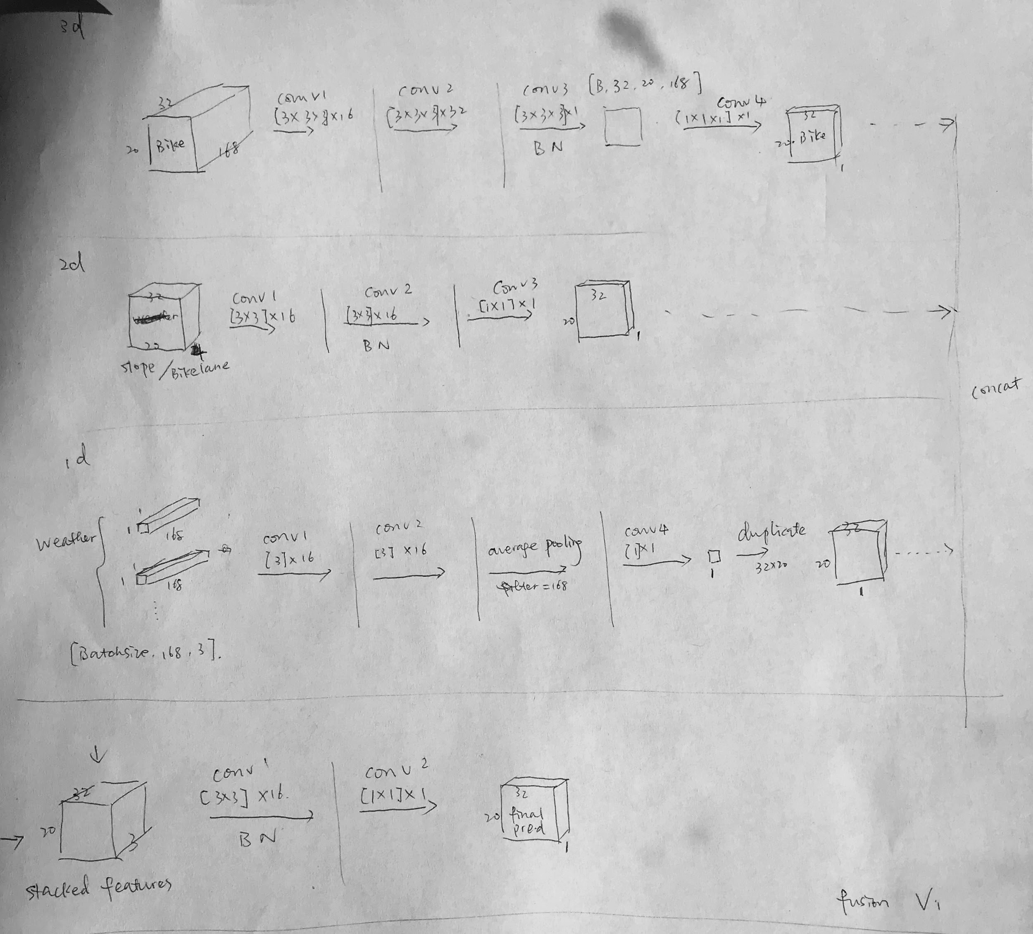

Slide 36
Baselines
2017-10-01 - 2018-10-31 lime data trip starts
training: 2017-10-01 - 2018-08-31 ; test: 2018-09-01 - 2018-10-31： Use one week data to predict next hour # of trip starts
 | RMSE | MAE
previous week Average | 2.5102 | 0.6794
average of previous hour h day of week d | 2.1547 | 0.4838
previous observation | 1.9312 | 0.5173
ARIMA | 3.59652 | 0.5383
LSTM | 1.8314 | 0.4679
ConvLSTM | 1.9107 | 0.4544
ConvLSTM with 10 demographic features | 1.8630 | 0.4197
3D CNN | 1.6802 | 0.3918
Fused Model V1 | 1.6419 | 0.3918
Notes:
try last 24 hours to predict next hour
try attention- model

Slide 37
Next
Run 3d cnn only with new structure (check)
Change structure (# of filter, add spatial pooling and deconvolution, temporal pooling -> maybe not helpful, prone to overfit and overgeneralize) (check)
Shuffle and do data augmentation to input series (check)
after fusion, use more filters (check)
modify loss function to force prediction > ground truth (check)
metric1: # of grids overesitmated / underestimated
metric2: # of bikes overestimated (white/black)
use pop density / employment density (see Puget Sound Regional Councils: https://www.psrc.org/covered-employment-estimates ) and use bus stops/ light rail stops as 2d input (see https://www5.kingcounty.gov/gisdataportal/) (check)
modify loss to enforce correct precentage prediction (check)
Add missing data masks
hyperparameter tuning
initialize with 3d cnn baseline (hold off)
use 500 m* 500 m grid / 250 m x 250 m

Slide 38
Predict O-D matrix using CNN
Interpret fairSTM: how does that work??
Map prediction / fair prediction
generate gap distribution. Compare distributions across groups
visualize changes imposed by fair prediction over time for each grid
How to use metrics defined by transportation lit in ML pipeline
How to do transfer learning between cities / tasks
GAN (domain adaptation)
- Seattle Tensor (fair representation)
- Multimask-learning
- autoencoder + GAN

Slide 39
Evaluate FairSTM using additional measurements like pos/neg residual difference
- Enforce individual fairness by defining similarity using city data (transporation/ POI / demo)
- Enforce overestimation and evaluate using different metrics (mean diff, pos/neg residual diff, social welfare, Dwork’s ). see Heidari, Hoda, et al. "Fairness behind a veil of ignorance: A welfare analysis for automated decision making." Advances in Neural Information Processing Systems. 2018

Slide 40
RideAustin Baselines
2016-08-01 - 2017-04-13 RideAustin trips
training: 2016-08-01 - 2017-02-28 ; test: 2017-03-01 - 2017-04-13： Use one week data to predict next hour # of trip
 | RMSE | MAE
previous week Average
average of previous hour h day of week d
previous observation
ARIMA
LSTM
ConvLSTM
ConvLSTM with 10 demographic features
3D CNN
Fused Model (1d + 3d)
Notes:
try last 24 hours to predict next hour
try attention- model

Slide 41
Fused Model V2
April 21

Slide 42
Features
1d: weather: sea level / temperature / rainfall (W)
2d: steep slope count, steep slope length (S)
bikelane count, bikelane length (B)
housing price (H)
3d: crime records (C)

Slide 43
Baselines
2017-10-01 - 2018-10-31 lime data trip starts
training: 2017-10-01 - 2018-08-31 ; test: 2018-09-01 - 2018-10-31： Use one week data to predict next hour # of trip starts
 | RMSE | MAE
previous week Average | 2.5102 | 0.6794
average of previous hour h day of week d | 2.1547 | 0.4838
previous observation | 1.9312 | 0.5173
ARIMA | 3.59652 | 0.5383
LSTM | 1.8314 | 0.4679
ConvLSTM | 1.9107 | 0.4316
3D CNN | 1.7436 | 0.4076
Notes:
try last 24 hours to predict next hour
try attention- model

Slide 44
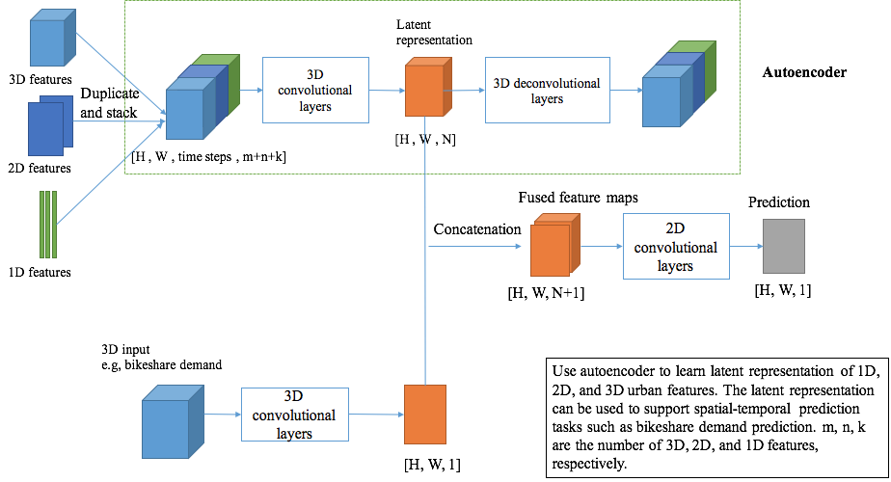

Slide 45
 | RMSE | MAE
3D CNN | 1.7436 | 0.4076
3D CNN + W | 1.6879 | 0.3867
3D CNN + C | 1.7200 | 0.4031
3D CNN + S + B | 1.6658 | 0.3776
3D CNN + S + B + W | 1.7005 | 0.3821
3D CNN + S + B + W + H | 1.6654 | 0.3783
3D CNN + S + B + W + C | 1.6175 | 0.3804
3D CNN + S + B + W + H + C
3D CNN + autoencoder latent feature | 1.7063 | 0.3928

Slide 46
 | Seattle |  | Austin
 | RMSE | MAE | RMSE | MAE
previous week Average | 2.5102 | 0.6794
average of previous hour h day of week d | 2.1547 | 0.4838 | 4.3923 | 0.6612
previous observation | 1.9312 | 0.5173
ARIMA | 3.59652 | 0.5383 | 3.34235 | 0.5973
LSTM | 1.8314 | 0.4679 | 4.2555 | 0.56974
ConvLSTM | 1.9107 | 0.4316 | 4.0250 | 0.5667
3D CNN | 1.7436 | 0.4076 | 3.1415 | 0.5320
3D CNN + 1D | 1.6879 | 0.3867 | 2.6995 | 0.4843
3D CNN + 1D + 2D | 1.6654 | 0.3783 | 2.6597 | 0.4724

